Slide 1
Unpicking a dissertation
Melda Salhab
Jan 29, 2020

Slide 2
Agenda
Unpicking the mark scheme
Before you start
Unpicking the dissertation
General tips

Slide 3
Unpicking the Mark Scheme

Slide 4
Unpicking the mark scheme
Review & Research Framing
Research Design
Analysis & Critical Reflection
Visualisation & Communication

Slide 5
Review & Research Framing
Background research
Multitude of credible sources
Narrative
A pertinent research question
Attribution of ideas
80-100% (A*) | 70-70% (A) | 60-69% (B)
Extensive and systematic background research evaluating a multitude of credible sources (e.g. academic and policy) using an in- depth and thorough narrative that seamlessly leads the reader to an innovative globally pertinent or topical research question. There is unambiguous attribution of ideas and no inaccuracies. | A broad range of background research evaluating a multitude of credible sources (e.g. academic and policy) using an extensive narrative to produce a convincing framing of a highly pertinent or topical research question. There is clear attribution of ideas with few inaccuracies. | A range of background research evaluating multiple forms of credible sources (e.g. academic and policy) with an adequately developed narrative to produce a legitimate farming of the pertinent or topical research question. Attribution of ideas is mostly clear with some minor inaccuracies.

Slide 6
Review & Research Framing
Think about how you can show that your literature review is extensive and systematic
Think about what do those terms mean in the context of your research
You can’t read everything, so consider how best to narrow down the scope of your research
Remember background research can cover data, study area, methods, tools, etc.
Quick win – only use credible sources
80-100% (A*) | 70-70% (A) | 60-69% (B)
Extensive and systematic background research evaluating a multitude of credible sources (e.g. academic and policy) using an in- depth and thorough narrative that seamlessly leads the reader to an innovative globally pertinent or topical research question. There is unambiguous attribution of ideas and no inaccuracies. | A broad range of background research evaluating a multitude of credible sources (e.g. academic and policy) using an extensive narrative to produce a convincing framing of a highly pertinent or topical research question. There is clear attribution of ideas with few inaccuracies. | A range of background research evaluating multiple forms of credible sources (e.g. academic and policy) with an adequately developed narrative to produce a legitimate farming of the pertinent or topical research question. Attribution of ideas is mostly clear with some minor inaccuracies.

Slide 7
Review & Research Framing
The literature review should be written as a story that leads to your research question
Essentially, you’re trying to show that you read and understood most of the literature on the subject, you found a gap, and you chose a research question that will fill that gap
Note: if your intended research has never been before, is there a reason for that? Could there be limits that you are not yet aware of?
80-100% (A*) | 70-70% (A) | 60-69% (B)
Extensive and systematic background research evaluating a multitude of credible sources (e.g. academic and policy) using an in-depth and thorough narrative that seamlessly leads the reader to an innovative globally pertinent or topical research question. There is unambiguous attribution of ideas and no inaccuracies. | A broad range of background research evaluating a multitude of credible sources (e.g. academic and policy) using an extensive narrative to produce a convincing framing of a highly pertinent or topical research question. There is clear attribution of ideas with few inaccuracies. | A range of background research evaluating multiple forms of credible sources (e.g. academic and policy) with an adequately developed narrative to produce a legitimate framing of the pertinent or topical research question. Attribution of ideas is mostly clear with some minor inaccuracies.

Slide 8
Review & Research Framing
Pertinent ≠ irrelevant
This is where you think about the ”So what?”
Aka what’s the point of my research?
Consider the potential broader implications of your research
Even if your research is very specific, could your approach be reproduced and potentially benefit many more people?
Global – while working on a global scale might help get these points, local research can definitely have global impacts
80-100% (A*) | 70-70% (A) | 60-69% (B)
Extensive and systematic background research evaluating a multitude of credible sources (e.g. academic and policy) using an in-depth and thorough narrative that seamlessly leads the reader to an innovative globally pertinent or topical research question. There is unambiguous attribution of ideas and no inaccuracies. | A broad range of background research evaluating a multitude of credible sources (e.g. academic and policy) using an extensive narrative to produce a convincing framing of a highly pertinent or topical research question. There is clear attribution of ideas with few inaccuracies. | A range of background research evaluating multiple forms of credible sources (e.g. academic and policy) with an adequately developed narrative to produce a legitimate framing of the pertinent or topical research question. Attribution of ideas is mostly clear with some minor inaccuracies.

Slide 9
Review & Research Framing
This should be a quick win – just cite all ideas correctly
Don’t write a block of text with 15 tabs and 7 windows open, planning to go back and cite later.
Each time you consult a paper, cite it. Right then and there. Make it a habit.
Background research
Multitude of credible sources
Narrative
A pertinent research question
Attribution of ideas
80-100% (A*) | 70-70% (A) | 60-69% (B)
Extensive and systematic background research evaluating a multitude of credible sources (e.g. academic and policy) using an in-depth and thorough narrative that seamlessly leads the reader to an innovative globally pertinent or topical research question. There is unambiguous attribution of ideas and no inaccuracies. | A broad range of background research evaluating a multitude of credible sources (e.g. academic and policy) using an extensive narrative to produce a convincing framing of a highly pertinent or topical research question. There is clear attribution of ideas with few inaccuracies. | A range of background research evaluating multiple forms of credible sources (e.g. academic and policy) with an adequately developed narrative to produce a legitimate framing of the pertinent or topical research question. Attribution of ideas is mostly clear with some minor inaccuracies.

Slide 10
Research Design
Reproducible research design
Based on a choice of data and methods
Understanding of techniques
Technical skills
Ethical reflection
Background research
Multitude of credible sources
Narrative
A pertinent research question
Attribution of ideas
80-100% (A*) | 70-70% (A) | 60-69% (B)
An innovative, expertly explained and fully, easily reproducible research design that is based on an exceptionally robust choice of data and methods. It demonstrates creativity, a comprehensive understanding of appropriate sophisticated techniques, exemplary technical proficiency and skills and extensive, critical ethical reflection. | An original, refined, fully explained and fully reproducible research design that is based on an entirely appropriate choice of data and methods. It demonstrates excellent understanding of appropriate techniques, technical proficiency and skills and critical ethical reflection. | A robust, well explained and mostly reproducible research design that is based on a well justified choice of data and methods. It demonstrates competent understanding of analytical techniques, sound technical ability and ethical reflection

Slide 11
Research Design
Innovation, creativity, and originality are obviously rewarded
Even if you are working with a pre-defined topic, think about how you can put a creative spin on it
If you are unsure as to what counts as innovative, ask your supervisor
Don’t be afraid to ask for a quick 10 min chats with experts in your field
Reproducibility – this is a minimum. No special skills are required. Just explain things really well. Put a link to your code. Make it pretty.
Background research
Multitude of credible sources
Narrative
A pertinent research question
Attribution of ideas
80-100% (A*) | 70-70% (A) | 60-69% (B)
An innovative, expertly explained and fully, easily reproducible research design that is based on an exceptionally robust choice of data and methods. It demonstrates creativity, a comprehensive understanding of appropriate sophisticated techniques, exemplary technical proficiency and skills and extensive, critical ethical reflection. | An original, refined, fully explained and fully reproducible research design that is based on an entirely appropriate choice of data and methods. It demonstrates excellent understanding of appropriate techniques, technical proficiency and skills and critical ethical reflection. | A robust, well explained and mostly reproducible research design that is based on a well justified choice of data and methods. It demonstrates competent understanding of analytical techniques, sound technical ability and ethical reflection

Slide 12
Research Design
Think about the difference between robust and justified in the context of choosing your data and methods
How can you convince the reader that your approach is the most appropriate choice?
Leverage your literature review
Background research
Multitude of credible sources
Narrative
A pertinent research question
Attribution of ideas
80-100% (A*) | 70-70% (A) | 60-69% (B)
An innovative, expertly explained and fully, easily reproducible research design that is based on an exceptionally robust choice of data and methods. It demonstrates creativity, a comprehensive understanding of appropriate sophisticated techniques, exemplary technical proficiency and skills and extensive, critical ethical reflection. | An original, refined, fully explained and fully reproducible research design that is based on an entirely appropriate choice of data and methods. It demonstrates excellent understanding of appropriate techniques, technical proficiency and skills and critical ethical reflection. | A robust, well explained and mostly reproducible research design that is based on a well justified choice of data and methods. It demonstrates competent understanding of analytical techniques, sound technical ability and ethical reflection

Slide 13
Research Design
Again creativity is important. Find a creative spin and make sure to explain how it’s creative
Think about how you can beyond just choosing a method and applying it competently
Try to achieve a level of understanding that would make you comfortable presenting your techniques
Critically, make sure you show your level of understanding
Ethical reflection – give this the time and effort it needs
Background research
Multitude of credible sources
Narrative
A pertinent research question
Attribution of ideas
80-100% (A*) | 70-70% (A) | 60-69% (B)
An innovative, expertly explained and fully, easily reproducible research design that is based on an exceptionally robust choice of data and methods. It demonstrates creativity, a comprehensive understanding of appropriate sophisticated techniques, exemplary technical proficiency and skills and extensive, critical ethical reflection. | An original, refined, fully explained and fully reproducible research design that is based on an entirely appropriate choice of data and methods. It demonstrates excellent understanding of appropriate techniques, technical proficiency and skills and critical ethical reflection. | A robust, well explained and mostly reproducible research design that is based on a well justified choice of data and methods. It demonstrates competent understanding of analytical techniques, sound technical ability and ethical reflection

Slide 14
Analysis & Critical Reflection of Findings
Interpretations of results
Narrative
Critical reflection
Critical reflections on the project’s outcomes, strengths, and limitations
If applicable, link to academic and policy debates
80-100% (A*) | 70-70% (A) | 60-69% (B)
Interpretations of results are exceptionally well constructed, clear and focused with a seamless narrative throughout. The discussion provides exemplary critical reflection on the project’s outcomes, strengths and limitations with extensive links to current academic and policy (if applicable) debates. | Interpretations of results are very well constructed, clear and focused with a well- developed narrative throughout. The discussion provides appropriate critical reflections on the project’s outcomes, strengths and limitations with good links to relevant academic and policy (if applicable) debates. | Interpretations of results are cogent and logically constructed argument with a consistent narrative throughout. Critical reflections on the project’s outcomes, strengths and limitations are present within the discussion with some linkage to academic and policy (if applicable) debates.

Slide 15
Analysis & Critical Reflection of Findings
Especially relates to your results, discussion, and conclusion sections
The importance of a narrative cannot be stressed enough
Don’t dump your results and describe the obvious
What story are you trying to tell your reader?
80-100% (A*) | 70-70% (A) | 60-69% (B)
Interpretations of results are exceptionally well constructed, clear and focused with a seamless narrative throughout. The discussion provides exemplary critical reflection on the project’s outcomes, strengths and limitations with extensive links to current academic and policy (if applicable) debates. | Interpretations of results are very well constructed, clear and focused with a well- developed narrative throughout. The discussion provides appropriate critical reflections on the project’s outcomes, strengths and limitations with good links to relevant academic and policy (if applicable) debates. | Interpretations of results are cogent and logically constructed argument with a consistent narrative throughout. Critical reflections on the project’s outcomes, strengths and limitations are present within the discussion with some linkage to academic and policy (if applicable) debates.

Slide 16
Analysis & Critical Reflection of Findings
You understanding your project’s outcomes, strengths, and limitations better than anyone
While you’re working through your data, write notes somewhere of your thoughts. It will make it a lot easier to write reflections later
Notice that how amazing your results are is not what’s being evaluated here. It’s how you interpret and reflect upon them
80-100% (A*) | 70-70% (A) | 60-69% (B)
Interpretations of results are exceptionally well constructed, clear and focused with a seamless narrative throughout. The discussion provides exemplary critical reflection on the project’s outcomes, strengths and limitations with extensive links to current academic and policy (if applicable) debates. | Interpretations of results are very well constructed, clear and focused with a well- developed narrative throughout. The discussion provides appropriate critical reflections on the project’s outcomes, strengths and limitations with good links to relevant academic and policy (if applicable) debates. | Interpretations of results are cogent and logically constructed argument with a consistent narrative throughout. Critical reflections on the project’s outcomes, strengths and limitations are present within the discussion with some linkage to academic and policy (if applicable) debates.

Slide 17
Analysis & Critical Reflection of Findings
If applicable (and it probably is applicable in some way), tie in your discussion to the bigger picture
Spend a bit of time doing research on any debates in your field
Could just be a chat with someone
80-100% (A*) | 70-70% (A) | 60-69% (B)
Interpretations of results are exceptionally well constructed, clear and focused with a seamless narrative throughout. The discussion provides exemplary critical reflection on the project’s outcomes, strengths and limitations with extensive links to current academic and policy (if applicable) debates. | Interpretations of results are very well constructed, clear and focused with a well- developed narrative throughout. The discussion provides appropriate critical reflections on the project’s outcomes, strengths and limitations with good links to relevant academic and policy (if applicable) debates. | Interpretations of results are cogent and logically constructed argument with a consistent narrative throughout. Critical reflections on the project’s outcomes, strengths and limitations are present within the discussion with some linkage to academic and policy (if applicable) debates.

Slide 18
Visualisation & Communication
Quality of visualisations
Appropriateness of visualisations
Quality of writing
80-100% (A*) | 70-70% (A) | 60-69% (B)
Visualisations, maps, figures and outputs are entirely appropriate and insightful for the data and analysis, and are of publication quality. Visualisations convey information expertly, demonstrating innovation and excellent design practice. The writing throughout is of exceptional quality, engaging and clear, being of publication quality. | Visualisations, maps, figures and outputs are highly capable and refined for the data and analysis, and are of high quality. Visualisations effectively convey information and demonstrate excellent design practice. The writing is of very high quality, engaging and clear. | Visualisations, maps, figures and outputs are clear and appropriate/effective but would benefit from slight improvements (e.g. too much irrelevant detail, or limitations in the visualisation type selected). The writing is of adequate quality and clear.

Slide 19
Visualisation & Communication
Think about what information could I visualise that would really add value
If you need inspiration, follow relevant accounts on twitter or other social media.
Think about (or Google) what makes the difference between okay and fantastic visualisations
80-100% (A*) | 70-70% (A) | 60-69% (B)
Visualisations, maps, figures and outputs are entirely appropriate and insightful for the data and analysis, and are of publication quality. Visualisations convey information expertly, demonstrating innovation and excellent design practice. The writing throughout is of exceptional quality, engaging and clear, being of publication quality. | Visualisations, maps, figures and outputs are highly capable and refined for the data and analysis, and are of high quality. Visualisations effectively convey information and demonstrate excellent design practice. The writing is of very high quality, engaging and clear. | Visualisations, maps, figures and outputs are clear and appropriate/effective but would benefit from slight improvements (e.g. too much irrelevant detail, or limitations in the visualisation type selected). The writing is of adequate quality and clear.

Slide 20
Visualisation & Communication
What is the goal of your visualisation, figure, map, or table?
Make sure the reader can understand without having to read the text
Don’t visualise everything you can for the sake of it
Don’t throw in a visualisation that might look cool but doesn’t ad much value
Ask a friend or your supervisor for their thoughts
80-100% (A*) | 70-70% (A) | 60-69% (B)
Visualisations, maps, figures and outputs are entirely appropriate and insightful for the data and analysis, and are of publication quality. Visualisations convey information expertly, demonstrating innovation and excellent design practice. The writing throughout is of exceptional quality, engaging and clear, being of publication quality. | Visualisations, maps, figures and outputs are highly capable and refined for the data and analysis, and are of high quality. Visualisations effectively convey information and demonstrate excellent design practice. The writing is of very high quality, engaging and clear. | Visualisations, maps, figures and outputs are clear and appropriate/effective but would benefit from slight improvements (e.g. too much irrelevant detail, or limitations in the visualisation type selected). The writing is of adequate quality and clear.

Slide 21
Visualisation & Communication
Whether you’re a natural born writer or not, exceptional quality writing requires time
You need time to write
You need time to revise and edit
You need a bit of courage to potentially slash or rewrite a section that might have taken you ages
It can be hard to proofread your own work, so consider helping each other out
80-100% (A*) | 70-70% (A) | 60-69% (B)
Visualisations, maps, figures and outputs are entirely appropriate and insightful for the data and analysis, and are of publication quality. Visualisations convey information expertly, demonstrating innovation and excellent design practice. The writing throughout is of exceptional quality, engaging and clear, being of publication quality. | Visualisations, maps, figures and outputs are highly capable and refined for the data and analysis, and are of high quality. Visualisations effectively convey information and demonstrate excellent design practice. The writing is of very high quality, engaging and clear. | Visualisations, maps, figures and outputs are clear and appropriate/effective but would benefit from slight improvements (e.g. too much irrelevant detail, or limitations in the visualisation type selected). The writing is of adequate quality and clear.

Slide 22
Key Takeaways
Really read the mark scheme.
Consult it every once in a while to see what you can do to get more points.
Aim for the best you possibly can. There is no reason not to.
Remember the goal of your dissertation is the dissertation.
It’s worth so much of your final grade, so give the paper the time it deserves.
If you have other goals, like trying to make a tool that you will sell for millions, do it, but later.

Slide 23
Before you start

Slide 24



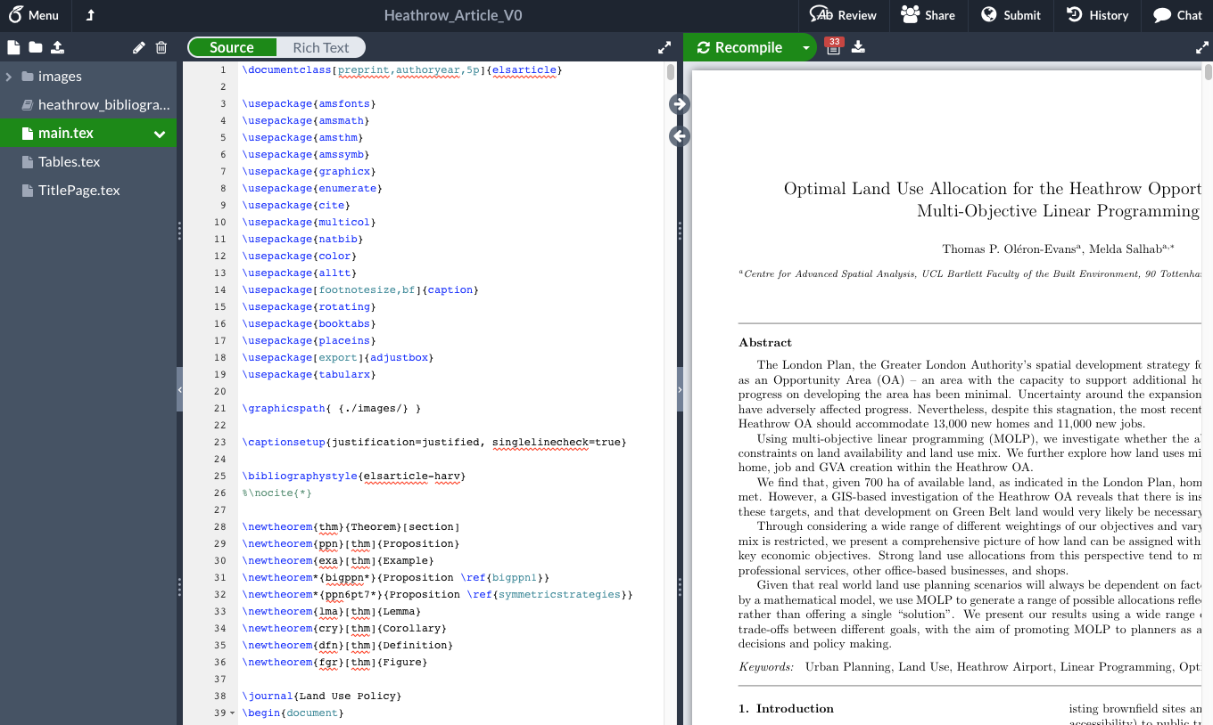
Writing / formatting tools

Slide 25



Reference Manager
Word plug-in
Browser plug-in
Download / select the correct citation style
Insert the citation quickly while you’re writing
One-click bibliography

Slide 26
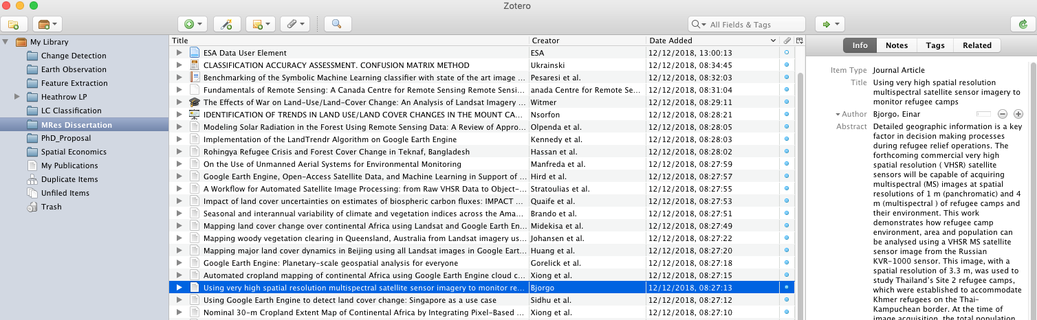
Reference Manager
Useful Extensions: Word plug in, browser plug in, Zotfile

Slide 27
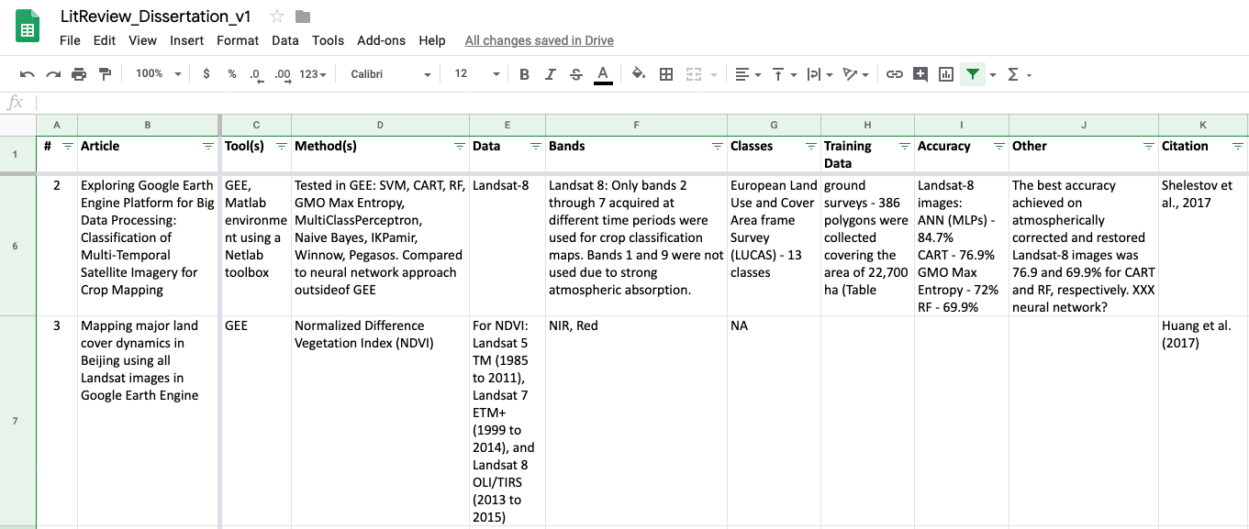
Literature Review

Slide 28
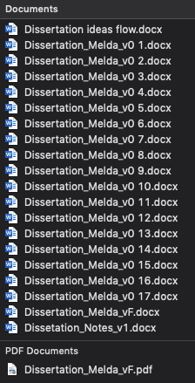
Backups, backups, backups
“My computer crashed while I was running my code and I lost all my documents” is not an excuse. We’re in 2020.
Assume your computer will crash at some point. Assume that your cat might spill your diet coke on your laptop. Plan for those scenarios.
Google Drive
Version control (manual or Git)
GitHub
Emails to yourself
Spastically pressing ctrl / cmd + s

Slide 29
Planning. Easier said than done.
REALITY
Unless you’re a superhuman who manages time perfectly, planning something you’ve never done before is hard.
Unless you fall deeply in love with your work, you will probably procrastinate at some point.
Computers crash. Code stops working.
Life will happen. Your water boiler might break. You might have to move flats. Your entire family might decide Aug 20th is the best time to enjoy London’s one week of summer.
WHAT DO TO ABOUT IT
Look at your calendar and set a realistic timeline.
Set hard interim deadlines.
Commit to them by emailing them to your supervisor. “I will send you X by July 2nd ”
Meet those deadlines. Pulling an all-nighter on July 1st is better than Aug 23rd .
Buffer time.
Set a date when you stop analysing and start writing.

Slide 30
Key Takeaways
Set up your environment before you start.
Choose a writing / formatting tool that you can confidently use.
Choose a reference manager and stick with it.
While reading your literature, record your notes in some systematic way.
Backups, backups, backups.
Assume worst case scenarios.
Plan. Set deadlines. Meet them.

Slide 31
Dissecting the Dissertation

Slide 32
Preamble
Dissertation
Structure
Introduction
Literature Review
Data & Methods
Results & Discussion
Conclusion
Bibliography
Appendices

Slide 33
1
Preamble
Order it will be in the final paper
2
Introduction
3
Literature Review
4
Data & Methods
5
Results & Discussion
6
Conclusion
7
Bibliography
8
Appendices

Slide 34
4
Preamble
Order you will actually work on it -ish
3
Introduction
1
Literature Review
2
Data & Methods
2
Results & Discussion
3
Conclusion
4
Bibliography
4
Appendices

Slide 35
Literature Review
TIPS TO FIND LITERATURE
Online library search
Google scholar
Web of Science
When you find a great paper, read it’s literature review, and search for potentially relevant sources.
Note: online tutorials, blogs, discussion forum posts, etc. that you use should also be cited.
TIPS TO REVIEW LITERATURE
Don’t try to read everything you download
Store your papers in a logical place
Better yet, link them to your reference manager
Come up with a structure to record your notes.
Even a couple words on your present thoughts will save you lots of time when it comes time to write.

Slide 36
Literature Review

Slide 37
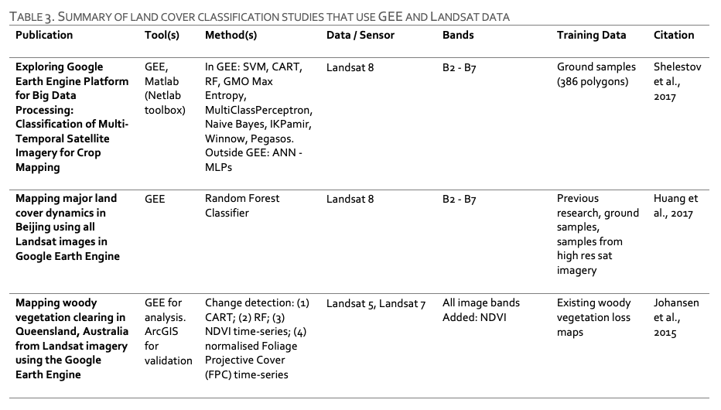
Literature Review
I actually put a table highlighting the most important papers directly in my dissertation.
My goal was to justify my choice of data and methods by showing what other studies had done.
Because I had taken notes in a structured way while reading, I was easily able to extract the most relevant information and create this table.
I only included the information that was particularly relevant to my narrative.

Slide 38
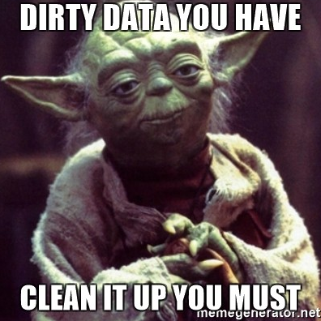
Data & Methods
Although you dive into your data and methods after your literature review, finding a good dataset will probably be the first thing you do.
The second thing will be thinking of what you want to do with this data. (Aka methods.)
Spend the time to truly understand your data and planned approach.
How long will it take to clean?
Have you worked with this data type / format before?
Can you test out your plan?
Will it require a lot of compute power?

Slide 39
Data & Methods
You will go back and forth a lot.
Try your best to pin down your dataset early - adjusting your research question is a lot easier than starting from an entirely new dataset.
Research Question
Data
Methods

Slide 40
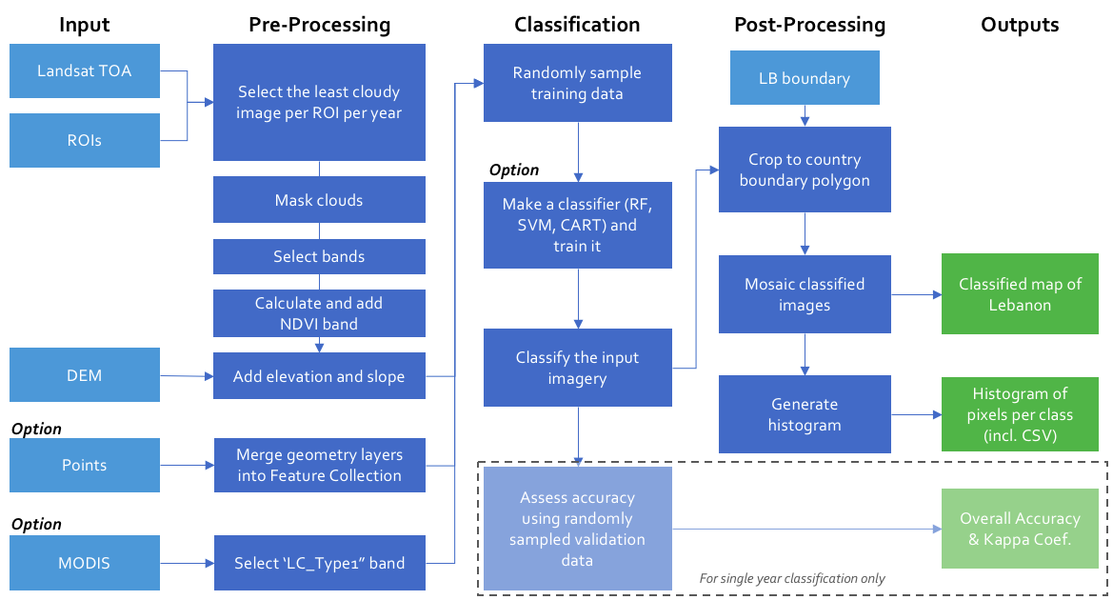
Data & Methods | Flowcharts
Explain your process as clearly as you possibly can.
Flowcharts are worth the time and effort.
Unless you have fancy software, I recommend doing this in PowerPoint

Slide 41
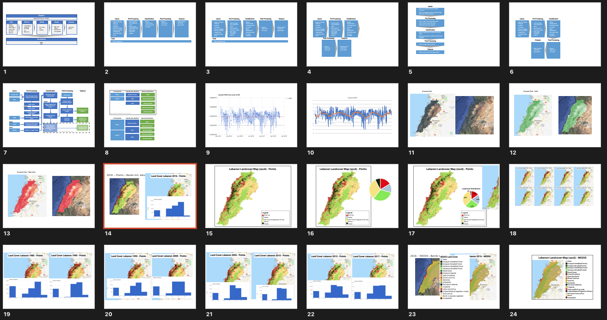
Results & Discussion
Have a place to put all your outputs, with brief notes on what code/method led to the output
I recommend PowerPoint because it’s easy to write notes and adjust minor formatting
You don’t want to be in a situation where you change your code, realize you prefer previous results, but can’t remember how you got them.

Slide 42
Results & Discussion
Be very selective about what you actually put into your paper.
Not all figures have to be in the results section. I used a chart from preliminary analysis to justify my proposed methods.

Slide 43
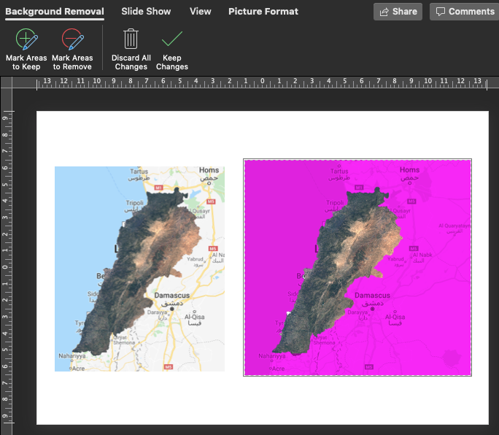

Results & Discussion | Tip
Low-tech solutions are sometimes okay.
Especially for final formatting of your outputs.

Slide 44
Introduction
This is (obviously) the first thing a person reads. Make it interesting.
Explain the context of your research. Remember the person reading may have no background info.
Explain your specific focus.
Explain the relevance. Why are you doing this research? Research gap? Pressing problem?
Explain your research aims, objectives, and your well-defined research question. (This can be a separate section)

Slide 45
Introduction | General Storytelling
Situation: explain the context.
Complication: explain the problem you want to address.
Resolution: Your research question that you aim to solve through your paper.

Slide 46
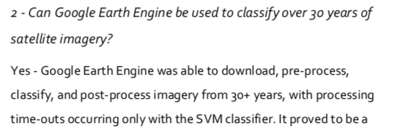
Conclusion
If you haven’t yet, make sure to explicitly address your research questions.
Discuss and critically reflect on limitations of your study. (Recall the mark scheme)
Tie your research into the bigger picture. What’s the point of everything you did?
Propose ideas for future research. This could help show that you understand the field beyond just your project.

Slide 47
My Structure
INTRODUCTION
RESEARCH TOPIC AND AIMS
Research Topic Justification
LITERATURE REVIEW
Existing land cover datasets – global
Existing land cover datasets – Lebanon
Land cover classification – GEE and Landsat
DATA
Data to classify: Landsat missions
Training data: MODIS & Researcher defined
Country boundary polygon
Digital elevation data
METHODOLOGY
Key Decisions
Classification Flowchart
Statement of Ethics
RESULTS & DISCUSSION
Single year land cover classification
Time series land cover classification
CONCLUSION
Addressing research questions
Study limitations
APPENDIX

Slide 48
Tips

Slide 49
Even if your research is Nobel Prize worthy, if it ain’t written, it ain’t passing
There are only so many marks you can get for research impact.
You have to write about it coherently AND submit on time.
Give yourself a very hard deadline for research and analysis, so you have enough time to write

Slide 50
Don’t fall in love with your writing
The value of a paragraph has nothing to do with the time you spent writing it.
Sometimes great writing will take a few minutes. Other times, when you’re not in the zone, it could take hours.

Slide 51
Other Random Tips
Book meetings with you supervisor from now until submission.
You know your content better than anyone so any shortcomings will be glowing to you, but that doesn’t mean your analysis is bad.
Two people mark your paper. You supervisor and a second person who knows nothing about your work. Make sure your paper is written with that person in mind.
PRINTING
Grey is a colour! (At some printing shops)
Make sure captions for your figures are not nudged onto the next page.
Book a slot at the printing shop.

